Slide 1

Business Analytics Project-Ready Dataset
Olatunde W Jolaosho
Title: E.ON Sales Data Analysis
Nexford University Milestone
7th September 2024

Slide 2

INTRODUCTION
The objective of this project is to analyze E.ON sales data and use it to gain insights into the company's sales performance over time. Understanding customer buying patterns, trends, and any anomalies within this dataset will help identify areas for improvement. Additionally, we will be able to forecast future sales and make data-driven decisions for the business.
Gaining insights from sales data is vital for effective decision-making as it reveals how revenue is generated, customer behavior, and product performance. Analyzing this dataset will provide E.ON with advantages such as efficient resource allocation, process improvements, and enhanced overall profitability.

Slide 3
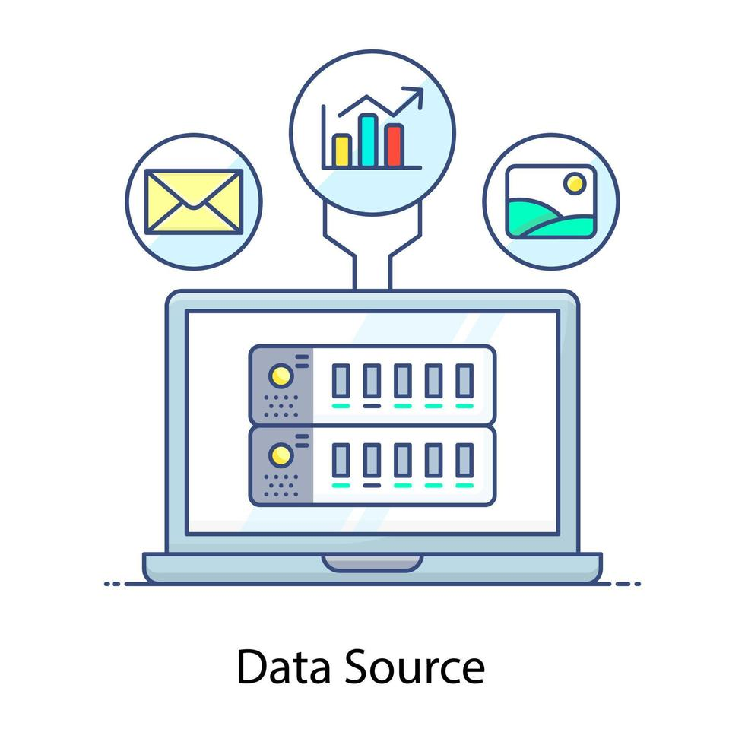
Relevant Data Source
The source of the data is internal, pulled from various E.ON systems, and provided in the form of an Excel file. This dataset includes key information such as sales figures, transaction dates, and product categories.
We have merged data from the Product table, Customer data, and Sales table to form the current dataset.
This combined data allows us to track sales performance over specific time periods, analyze product sales, and examine customer purchasing trends, among other insights. By leveraging this structured dataset, we can explore and gain meaningful insights into E.ON’s sales activities.

Slide 4
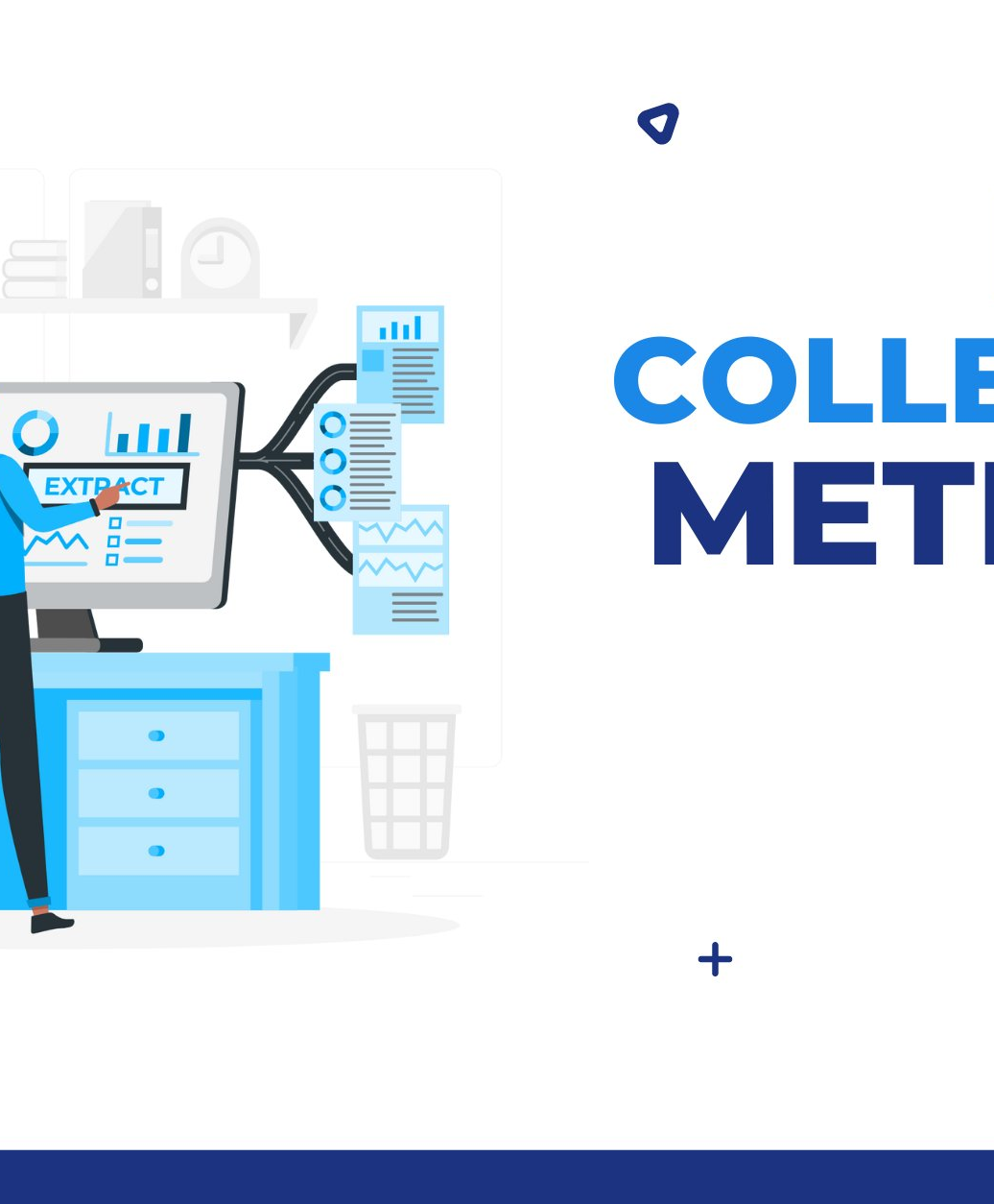
Data Collection Methods & Tools:
Automated data Collection -Data was collected by E.ON through automated collection, the company has built some business applications and websites that help to collect customer data, it also help to process orders for the business.
Tools: The data we are working with was provided in an Excel format, containing sales, product, order, and customer data. We processed this data using Structured Query Language (SQL), joining key variables from these different tables based on their primary and secondary keys.

Slide 5

Steps Taken to Clean the Data
According to BenardOkasi (2021), he stated steps to clean dataset may vary slightly due to different research methodology, and if the data is largely quantitative or qualitative. However, with this data we will be cleaning the data with this steps below:
Handling Missing Values: Explaining how missing data will be handled
Data Cleaning: Removal of duplicates, correction of any data entry errors.
Date Formatting: Ensuring all date formats are consistent.
Categorization: Standardizing product categories if necessary.

Slide 6
Steps Taken to Clean the Data Cont’d
Handling Missing Values: We filled the missing values with appropriate replacements, using the mean or median for numerical data where applicable. Additionally, any rows with incomplete information were removed to maintain data quality.
01
Data Cleaning: We removed any duplicate data entries and corrected errors to ensure consistency throughout the dataset.
02
Date Formatting: All date fields were checked and standardized to a consistent format to ensure uniformity across the dataset.
03
Categorization: The product categories were reviewed and corrected for any naming inconsistencies or variations that could cause discrepancies in the analysis.
04

Slide 7
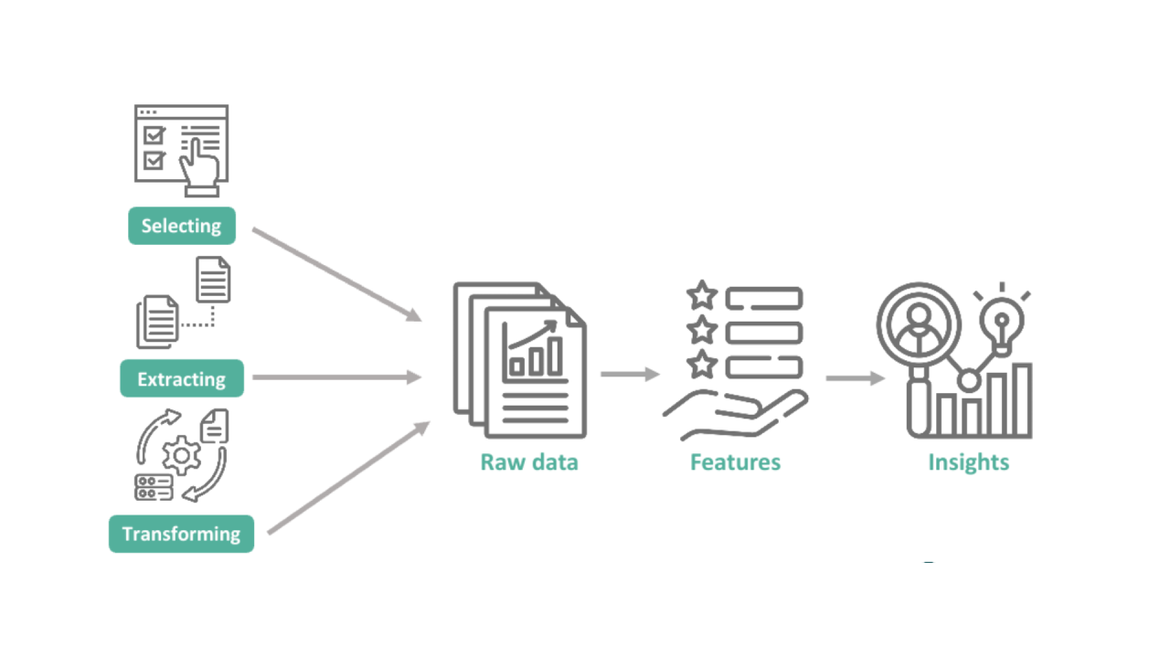
Transformations Applied to the Data
According to Probyto AI (2023), feature engineering is crucial as it simplifies the learning process, reduces computational complexity, and enhances model generalization, enabling machine learning models to make more accurate predictions. Hence, we will be transforming our data through the below
Data Transformations: We converted sales data into consistent units across the dataset to ensure meaningful comparisons between different scales.
Feature Engineering: We calculated sales growth percentages to track changes over time and aggregated daily sales to better understand trends. This approach provides deeper insights, enabling more comprehensive analysis.

Slide 8
Data Combination from Sources & Compatibility
The data we will be working with was provided in an Excel format, and this contained sales, product, order and customer data. We had processed this data using Structured Query Language(SQL). we had joined important variables from these different data tables together through their primary and secondary keys, such as customer IDs, product IDs, or order numbers, to ensure accurate data integration.
We used SQL to manipulate, clean the data and efficiently handle the dataset. This approach ensures the data we used is well-structured and ready for data analysis.
Compatibility: During the process, we encountered some compatibility issues, such as differences in data formats and column mismatches. For example, date formats across tables were inconsistent, so we standardized them to a uniform format to facilitate merging.

Slide 9
Data Quality Assessment
To address the data quality assessment, we will evaluate the following key factors:
Data Accuracy
Data Completeness
Data Reliability
Additionally, we will consider potential biases, discuss relevant ethical considerations, and highlight any limitations within the dataset.

Slide 10

Data Quality Assessment Cont’d
In this project:
Data Accuracy: The data showed no major inconsistencies, and any errors found during the cleaning process were corrected to ensure accuracy.
Data Completeness: Missing data was handled by using the mean or median to fill gaps, maintaining the integrity of the dataset.
Data Reliability: The data was sourced from E.ON’s internal databases, making it a reliable foundation for our analysis.
Potential Biases and Ethical Considerations: We ensured that no biases were introduced due to missing or incomplete customer information. Ethical considerations regarding customer privacy were also addressed, ensuring compliance with GDPR when handling sensitive data.

Slide 11
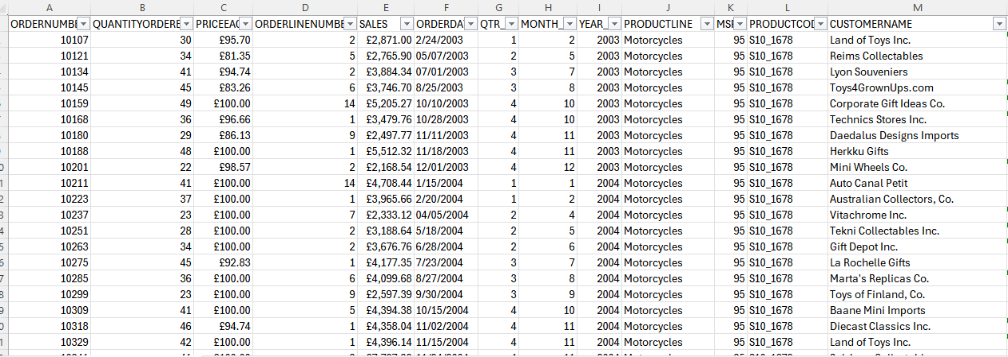
Snippet of the Dataset

Slide 12
Summary of Prepared Dataset
The final dataset has been thoroughly cleaned, transformed, and prepared for analysis. Missing values have been addressed, duplicates removed, and data inconsistencies resolved. Key transformations, such as standardizing date formats and calculating new features like sales growth percentage, have also been applied.
This E.ON dataset contains accurate, consistent, and well-structured information across sales, product, order, and customer data, and it ready for analysis and modeling. This prepared dataset will allow us to extract meaningful insights and drive data-driven business decisions.

Slide 13
REFERENCES
Ai, P. (2023, July 21). Feature Engineering: Unveiling the art of data transformation for Machine learning. https://www.linkedin.com/pulse/feature-engineering-unveiling-art-data-transformation-machine/
BenardOkasi. (2021, April 7). Data cleaning: Steps to Clean data. GeoPoll. https://www.geopoll.com/blog/data-cleaning-steps-to-clean-data/

